Slide 1
CP2404/CP5633 Database Modelling
Lecture 03

Slide 2
Lecture 3
Entity Relationship Model
Reading: Coronel’s Chapter 3 & 4
Notes:
2

Slide 3
Learning Objectives
In this lecture, you will learn:
The components of Entity Relationship Diagram (ERD)‏
How relationships between entities are defined
How ERD components affect database design and implementation
Conflicting goals in the real-world database design
Notes:
3

Slide 4
Basic Modelling Concepts
Models
“Description or analogy used to visualize something that cannot be directly observed” Webster’s Dictionary
Data Model
Relatively simple representation of complex real-world data structures
Art and science
Good judgment coupled with powerful design tools
4

Slide 5
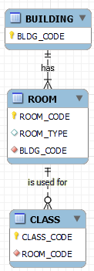
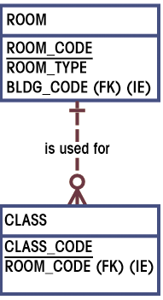
The ERD Components
ERD Maps E-R model
Chen
Crow’s Foot
Entities
Corresponds to entire table, not row
Represented by rectangle
Entity name, a noun, in capital letters
Attributes
Corresponds to columns in tables
Listed in the rectangle (with P.K. underlined)‏
Relationships
Reflected by P.K. and F.K. pairs
Represented by lines among entities (with bars and crow’s foot symbols specifying details)‏
5

Slide 6
4-Steps to Get You an ERD
Create a detail narrative of the organization’s operations
Identify the business rules based on the description
Develop the initial ERD
Identify entities through narrative description and business rules(nouns)‏
Identify relationships among the entities (1:1; 1:M; M:N)‏
Specify attributes within each entity
Check/specify all the details (e.g. weak entity)‏
Revise and review the ERD
6

Slide 7
4-Steps to Get You an ERD
Create a detail narrative of the organization’s operations
Identify the business rules based on the description
Develop the initial ERD
Identify entities through narrative description and business rules(nouns)‏
Identify relationships among the entities (1:1; 1:M; M:N)‏
Specify attributes within each entity
Check/specify all the details (e.g. weak entity)‏
Revise and review the ERD
7

Slide 8
Step 1. Identify Entities through Narrative Description
Rules of thumb
Catch nouns in the description
Determine whether you want to collect any information about that object
If “Yes”, keep it as a potential entity
If “No”, leave it out
8

Slide 9

ERD Example Discussions
The Jonesburgh County Basketball Conference (JCBC) is an amateur basketball association. Each city in the country has one team as its representative. Each team has a maximum of 12 players and a minimum of 9 players. Each team also has up to three coaches (offensive, defensive, and physical training coaches). During the season, each team plays two games (home and visitor) against each of the other teams. Given those conditions, do the following:
Task
Identify possible entities for this scenario
9

Slide 10
4-Steps to Get You an ERD
Create a detail narrative of the organization’s operations
Identify the business rules based on the description
Develop the initial ERD
Identify entities through narrative description and business rules(nouns)‏
Identify relationships among the entities (1:1; 1:M; M:N)‏
Specify attributes within each entity
Check/specify all the details (e.g. weak entity)‏
Revise and review the ERD
10

Slide 11
Step 2. Identify Relationships among Entities
There are only three types of relationships
1:1 – Rare, mostly in the special case
(e.g. Supertype/Subtype relationship, 3NF enforcement)
1:M – Most common, and most desirable
M:N – Quite common, once identified, needs to be broken down into two pairs of 1:M relationships
11

Slide 12
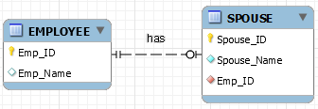
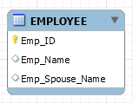
Step 2. Identify Relationships
1:1
OR
12

Slide 13



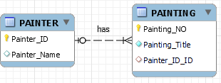


Step 2. Identify Relationships
1:M
13

Slide 14
Step 2. Identify Relationships
M:N
14

Slide 15
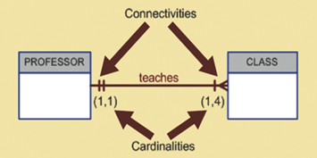
Step 2. Identify Relationships
(Connectivity vs. Cardinality)
Connectivity describes relationship classification (1:1, 1:M, M:N)‏
Cardinality expresses number of entity occurrences associated with one occurrence of related entity
Cardinalities are established by very concise statements included in business rules.
Not all business rules can be represented in an E-R diagram.
15

Slide 16
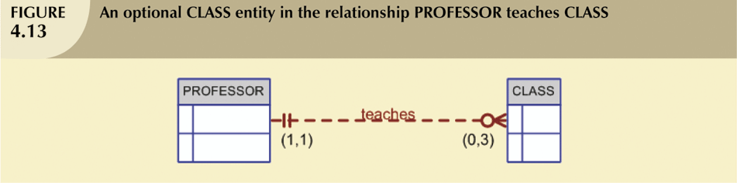

Step 2. Identify Relationships
(Relationship Participation)
Optional participation
One entity occurrence does not require corresponding entity occurrence in particular relationship
Mandatory participation
One entity occurrence requires corresponding entity occurrence in particular relationship
16

Slide 17
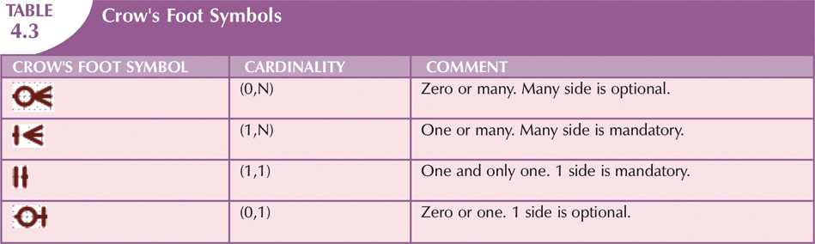
Step 2. Identify Relationships
(Relationship Participation)
17

Slide 18
General Rules for FK: 1:1
1:1 Relationship
If both entities are in a mandatory participation in the relationship and they do not participate in other relationships, it is most likely that the two entities should be part of the same entity.
If we decide to use two tables to present the two entities:
General Rules: Put Foreign Key in the strong entity or in the most frequently accessed entity or in the entity selected by the semantics of the problem.
PROFESSOR (PROF_NUM, PROF_NAME, PC_NUM)‏
PC (PC_NUM, PC_BRAND, PC_MEM, PC_CPU, PC_HD)‏
18

Slide 19
Example: 1:1 Relationship
PROFESSOR
Is in
ROOM
❶
PRO_CODE
PRO_NAME
ROM_CODE
❷
PRO_CODE
PRO_NAME
MIS002
Jerry Chang
B344
MIS002
Jerry Chang
ACC098
Albert Lee
A123
ACC098
Albert Lee
MIS007
Weiyin Hong
B312
MIS007
Weiyin Hong
ROM_CODE
ROM_LOC
ROM_CODE
ROM_LOC
PRO_CODE
B312
Beam Hall
B312
Beam Hall
MIS007
B344
Beam Hall
B344
Beam Hall
MIS002
A123
FEH
A123
FEH
ACC098
19

Slide 20
General Rules for FK: 1:M
1:M Relationship
General Rules: Create the foreign key by putting
the primary key of the “1” in the
table of the “M”.
GALLERY (GAL_NUM, GAL_OWNER, GAL_RATE)‏
PAINTING (PTNG_NUM, PTNG_TITLE, PTNG_PRICE, GAL_NUM)‏
20

Slide 21
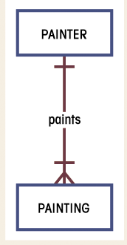
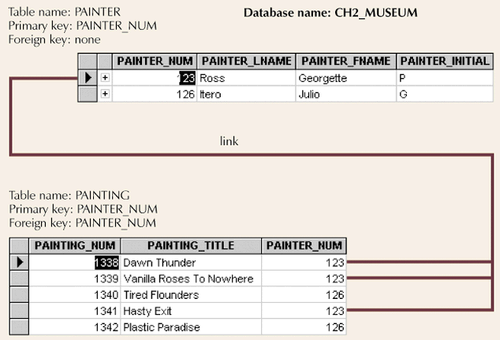
Example: 1:M Relationship
21

Slide 22
General Rules for FK: M:N
M:N Relationship
General Rules: Convert the M:N relationship to a
composite (bridge) entity consisting
of (at least) the parent tables’
primary keys.
STUDENT (STU_NUM, STU_NAME)‏
CLASS (CLS_CODE, CLS_TIME, ROM_CODE)‏
ENROLL (CLS_CODE, STU_NUM, GRADE)‏
Parent tables
Bridge table
22

Slide 23
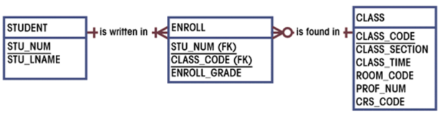
Composite Entities (a.k.a. bridge tables)
To ‘bridge’ between M:N relationships
Composite entity composed of primary keys of each entity needing connection
Composite entity may (and normally DO!) contain additional attributes
Composite Entity
2 pairs of 1:M Relationships
23

Slide 24
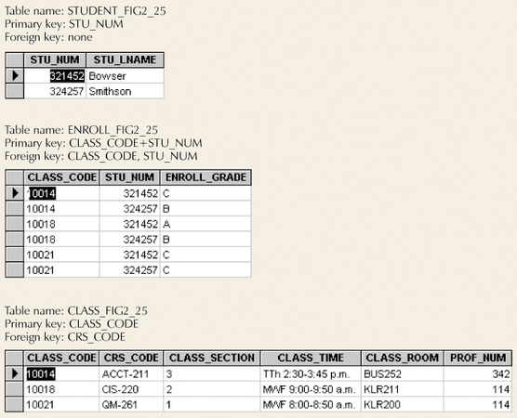
Create an ERD on Workbench to present the M:N relationship shown as below. ‏
24

Slide 25
ERD Examples Discussions
The Jonesburgh County Basketball Conference (JCBC) is an amateur basketball association. Each city in the country has one team as its representative. Each team has a maximum of 12 players and a minimum of 9 players. Each team also has up to three coaches (offensive, defensive, and physical training coaches). During the season, each team plays two games (home and visitor) against each of the other teams. Given those conditions, do the following:
Task
Identify the connectivity of each relationship.
Identify the cardinality between teams and players and between teams and city.
25

Slide 26
4-Steps to Get You an ERD
Create a detail narrative of the organization’s operations
Identify the business rules based on the description
Develop the initial ERD
Identify entities through narrative description and business rules(nouns)‏
Identify relationships among the entities (1:1; 1:M; M:N)‏
Specify attributes within each entity
Check/specify all the details (e.g. weak entity)‏
Revise and review the ERD
26

Slide 27
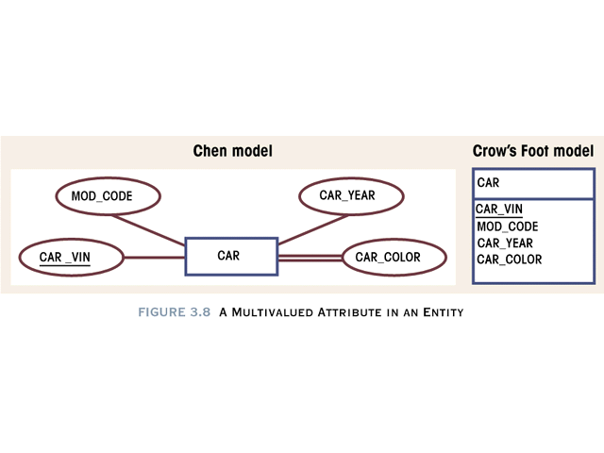
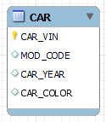
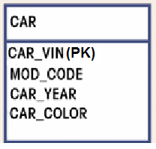
Step 3. Identify Attributes
(Primary Key attribute)
Essential attribute of each table – Primary Key !!
Notation of Primary keys (Various ways depending on ERD drawing tools
Underlined
Put (PK) next to the primary key(s)
Key Symbol
‏
27

Slide 28
Step 3. Identify Attributes ‏
Attributes
Simple
Composite*
Characteristics
Can’t be subdivided
Can be subdivided into additional attributes
Example
Age, Sex, Marital status
Address into street, city, zip
* Don’t get confused with the Composite Key (which is a primary key set
composed with more than one attribute)
28

Slide 29
Step 3. Identify Attributes ‏
Attributes
Single-valued
Multivalued
Characteristics
Can have only a single value
Can have many values
Example
Person has only one social security number
Person may have several college degrees
29

Slide 30
Step 3. Identify Attributes
- How to handle multivalued attributes?
The relational DBMS cannot implement multivalued attributes.
CAR table
Possible courses of action for the designer
Within the original entity, create several new attributes, one for each of the original multivalued attribute’s components.
Create a new entity composed of the original multivalued attribute’s components.
CAR_VIN | MOD_CODE | CAR_YEAR | CAR_COLOUR
QLD0001 | 00112 | 2017 | Silver, Blue, Silver
… | … | … | …
… | … | … | …
30

Slide 31
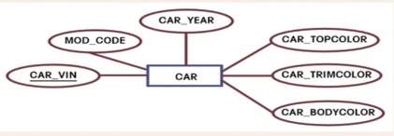
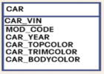
Step 3. Identify Attributes
- How to Handle Multivalued Attributes?
Possible courses of action for the designer
Within the original entity, create several new attributes, one for each of the original multivalued attribute’s components.
31

Slide 32
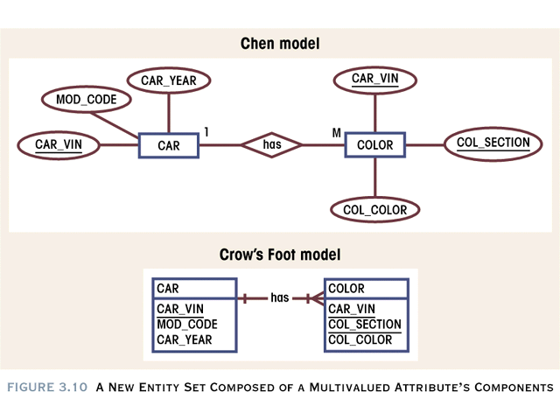
Step 3. Identify Attributes
- How to Handle Multivalued Attributes?
Possible courses of action for the designer
Create a new entity composed of the original multivalued attribute’s components.
32

Slide 33
Step 3. Identify Attributes ‏
Attributes
Derived
Characteristics
Can be derived with algorithm (computation)‏
Example
Age can be derived from date of birth
Actions
If the derived attribute is often queried upon, then keep it in the table.
If the derived attribute is not visited very often, then do not have to keep it in the table. (Compute by Query)‏
33

Slide 34
4-Steps to Get You an ERD
Create a detail narrative of the organization’s operations
Identify the business rules based on the description
Develop the initial ERD
Identify entities through narrative description and business rules(nouns)‏
Identify relationships among the entities (1:1; 1:M; M:N)‏
Specify attributes within each entity
Check/specify all the details (e.g. weak entity)‏
Revise and review the ERD
34

Slide 35
Step 4. Detailed Specification of Relationships
Relationship Strength
Existence dependence; Weak entities
Relationship Degree
Unary; Binary; Ternary
35

Slide 36
Step 4. Detailed Specification of Relationships
(Relationship Strength)
Existence Dependency
If an entity’s existence depends on the existence of one or more other entities, it is said to be existence-dependent.
e.g. CLASS is existence-dependent on COURSE
The order in which the tables are created and loaded is very important.
36

Slide 37
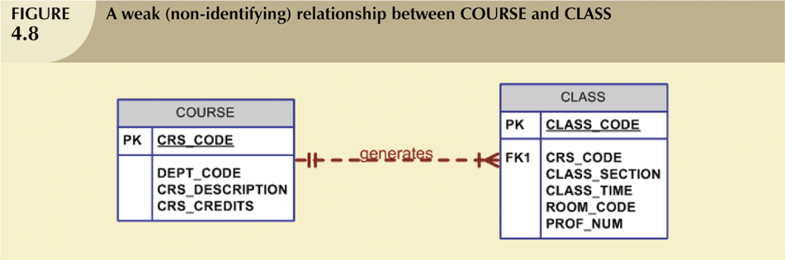
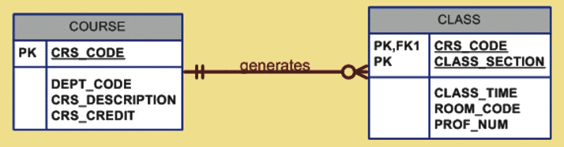
Step 4. Detailed Specification of Relationships
(Relationship Strength)
Weak (non-identifying) relationships
Exists if PK of related entity does not contain PK component of parent entity
Strong (Identifying) Relationships
Exists when PK of related entity contains PK component of parent entity
37

Slide 38
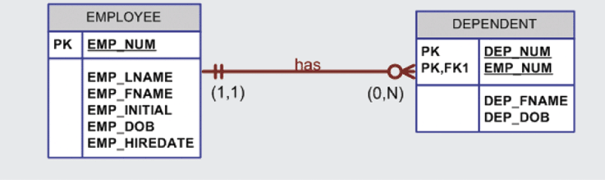
Step 4. Detailed Specification of Relationships
(Relationship Strength)
Weak Entity*
Existence-dependent on another entity
Has primary key that is partially or totally derived from parent entity
* Weak Entity is connected by a Strong Relationship with its parent entity
38

Slide 39
ERD Examples Discussions
The Jonesburgh County Basketball Conference (JCBC) is an amateur basketball association. Each city in the country has one team as its representative. Each team has a maximum of 12 players and a minimum of 9 players. Each team also has up to three coaches (offensive, defensive, and physical training coaches). During the season, each team plays two games (home and visitor) against each of the other teams. Given those conditions, do the following:
Task
Identify the type of dependency that exists between CITY and TEAM.
Identify the dependency between coach and team and between team and player.
39

Slide 40
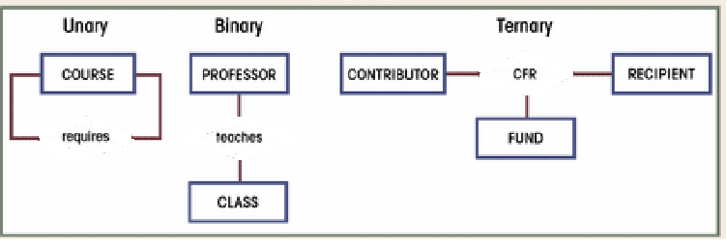
Step 4. Detailed Specification of Relationships
(Relationship Degree)
Indicates number of associated entities
Unary
Single entity
Recursive Relationship
Binary
Two entities associated
Ternary
Three entities associated
40

Slide 41
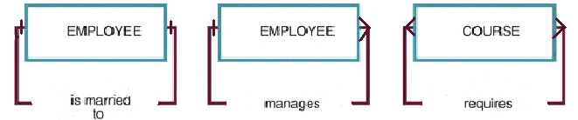
Step 4. Detailed Specification of Relationships
- Unary (Recursive) Relationship
Recursive Entities
A recursive entity is one in which a relationship can exist between occurrences of the same entity set.
A recursive entity is found within a unary relationship.
41

Slide 42
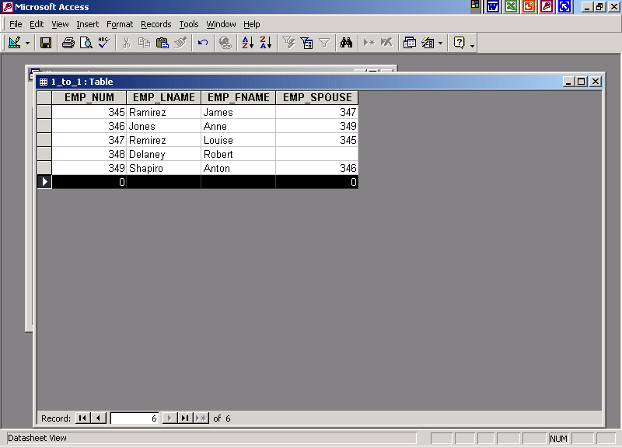
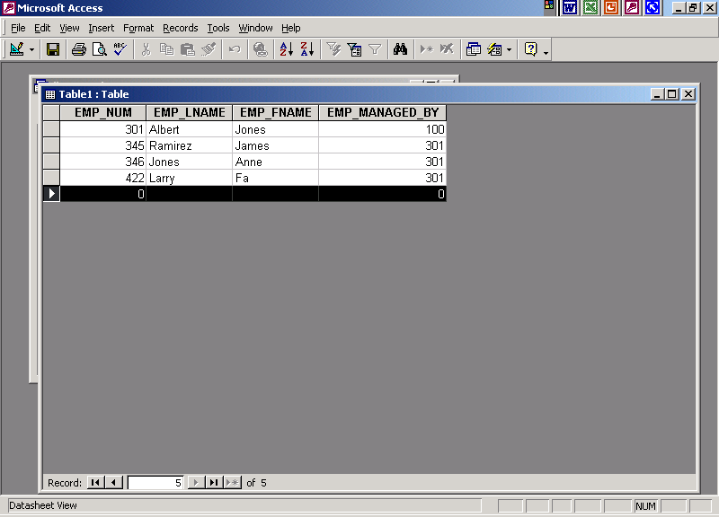
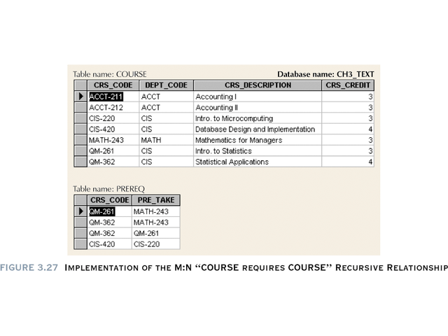
Create an ERD on Workbench to implement each of the following recursive relationships ‏
1:1
1:M
M:N
Bridge table
42
42

Slide 43
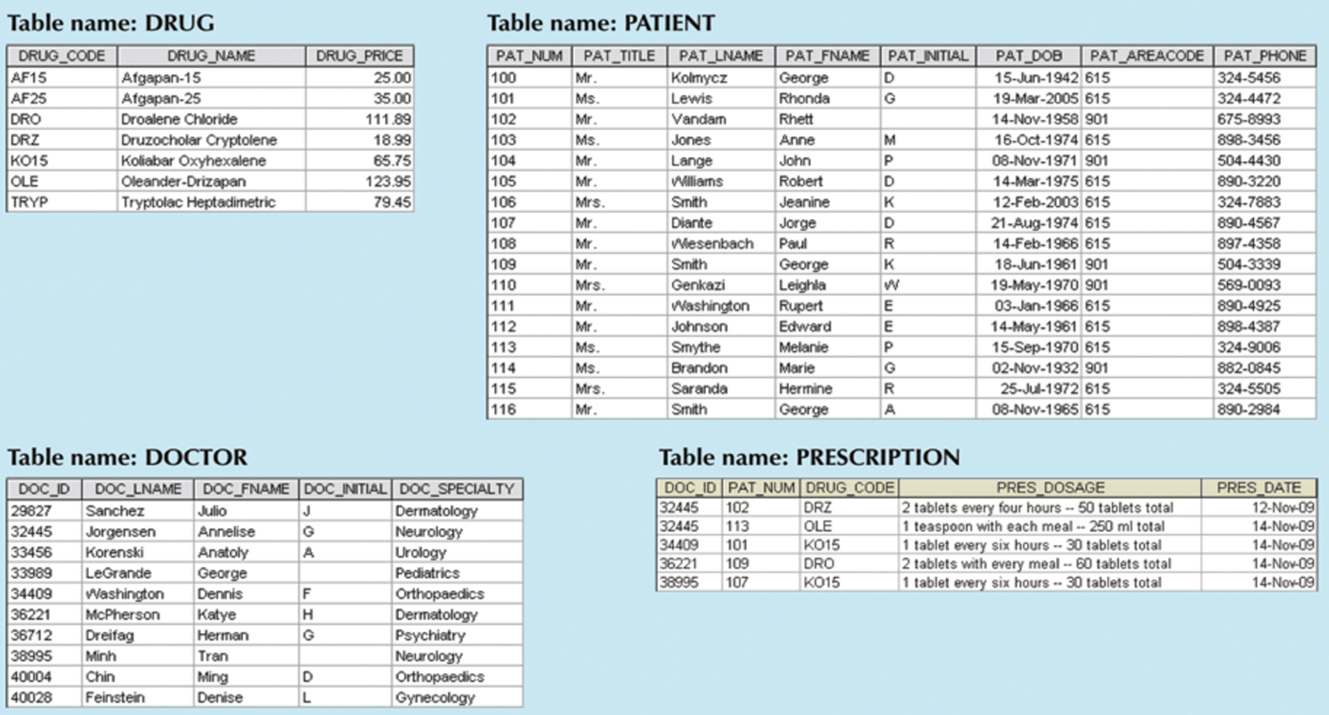
Step 4. Detailed Specification of Relationships
(Ternary Relationship)
43

Slide 44
Create an ERD on Workbench to implement the relationships as shown below‏
44

Slide 45
4-Steps to Get You an ERD
Create a detail narrative of the organization’s operations
Identify the business rules based on the description
Develop the initial ERD
Identify entities through narrative description and business rules(nouns)‏
Identify relationships among the entities (1:1; 1:M; M:N)‏
Specify attributes within each entity
Check/specify all the details (e.g. weak entity)‏
Revise and review the ERD
45

Slide 46
Challenge of Database Design
Conflicting Goals
Design standards (design elegance)‏
Processing speed
Information requirements
Design Considerations
Security
Performance
Shared access
Integrity
46

Slide 47
Database Design Challenges‏
1
EMP_NUM | EMP_LNAME | EMP_DEGREE
123 | Carter | AA, BBA
124 | O’Shanski | BBA, MBA, Ph.D.
125 | Jones | AS
126 | Ortez | BS, MS
Goods ?
Bads?
Need compromising for some purposes?
2
EMP_NUM | EMP_LNAME | EMP_DEGREE1 | EMP_DEGREE2 | EMP_DEGREE3
123 | Carter | AA | BBA
124 | O’Shanski | BBA | MBA | Ph.D.
125 | Jones | AS
126 | Ortez | BS | MS
3
EMP_NUM | EMP_LNAME
123 | Carter
124 | O’Shanski
125 | Jones
126 | Ortez
EMP_NUM | DEGREE_CODE | DEGREE_DATE | DEGREE_PLACE
123 | AA | May-1999 | Lake Sumter CC
123 | BBA | Aug-2004 | U. of Georgia
124 | BBA | Dec-1990 | U. of Toledo
124 | MBA | May-2001 | U. of Michigan
124 | Ph.D. | Dec-2005 | U. of Tennessee
125 | AS | Aug-2002 | Valdosta State
126 | BS | Dec-1989 | U. of Missouri
126 | MS | May-2002 | U. of Florida
47

Slide 48
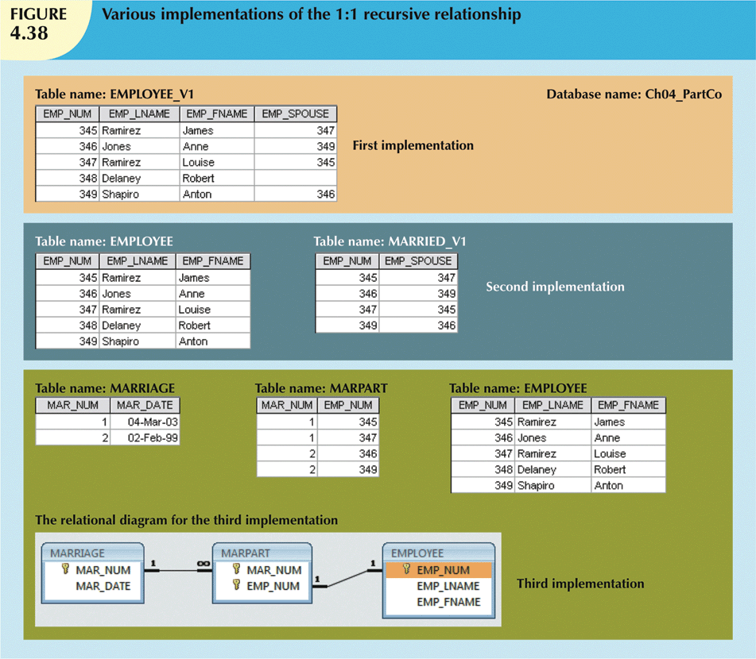
Database Design Challenges‏
Goods ?
Bads?
Need compromising for some purposes?
Security
Performance
Shared access
Integrity
48

Slide 49
ERD Examples Discussions
The Jonesburgh County Basketball Conference (JCBC) is an amateur basketball association. Each city in the country has one team as its representative. Each team has a maximum of 12 players and a minimum of 9 players. Each team also has up to three coaches (offensive, defensive, and physical training coaches). During the season, each team plays two games (home and visitor) against each of the other teams. Given those conditions, do the following:
Task
Draw the Crow’s Foot ERDs to represent the JCBC database.
49

Slide 50
Summary
Entity relationship (ER) model
Uses ERD to represent conceptual database as viewed by end user
ERM’s main components:
Entities
Relationships
Attributes
Includes connectivity and cardinality notations
Connectivities and cardinalities are based on business rules
In an ER model, M:N relationship is valid at conceptual level
Database designers are often forced to make design compromised
50

